Slide 1



Reinforcement Learning
张江
北京师范大学系统科学学院教授
集智俱乐部、集智学园创始人
集智研究中心理事长
北师大系统科学学院：面向复杂系统的人工智能，2024
Notes:
封面

Slide 2
Outline
Basic Notions
AlphaGo
Deep Q-Learning
Reinforcement Learning and Causality
World Models
北师大系统科学学院：面向复杂系统的人工智能，2024

Slide 3
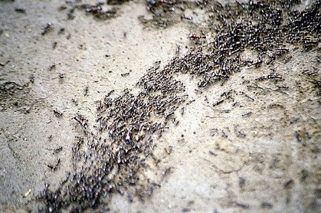
Why RL?
Complex System
Behavior (observations)
AI systems
Models
Prediction, Simulation, Optimization, Controls
北师大系统科学学院：面向复杂系统的人工智能，2024

Slide 4
A Complete Agent
智能体（Intelligent agent）应该是一个完整的可以感知、决策、行动、学习的整体，而不是分开的一系列任务
北师大系统科学学院：面向复杂系统的人工智能，2024

Slide 5
Some Cases
北师大系统科学学院：面向复杂系统的人工智能，2024

Slide 6
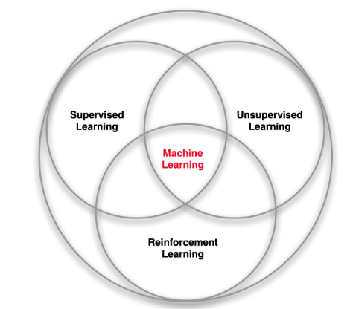
Territory
北师大系统科学学院：面向复杂系统的人工智能，2024

Slide 7
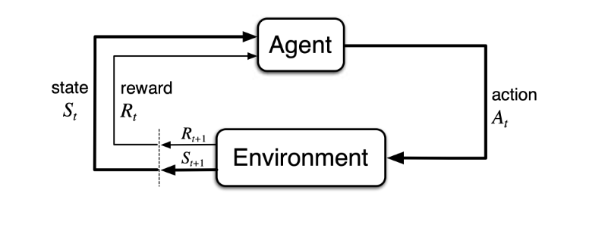
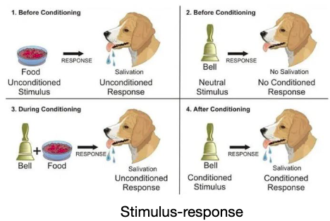
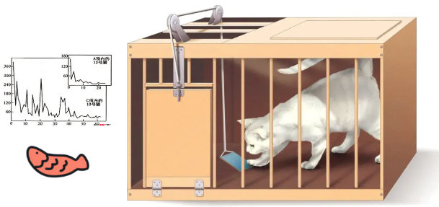
Early histories of RL
Trial-and-Error learning in Psychology
Optimal control and its solution with dynamic programming
Temporal difference learning
北师大系统科学学院：面向复杂系统的人工智能，2024

Slide 8
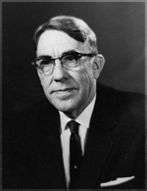
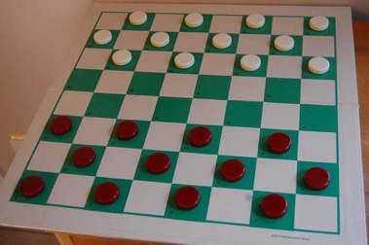
Early history of RL
Reinforcement learning (RL) is an area of machine learning inspired by behaviourist psychology, concerned with how software agents ought to take actions in an environment so as to maximize some notion of cumulative reward.
Arthur Samuel
北师大系统科学学院：面向复杂系统的人工智能，2024

Slide 9
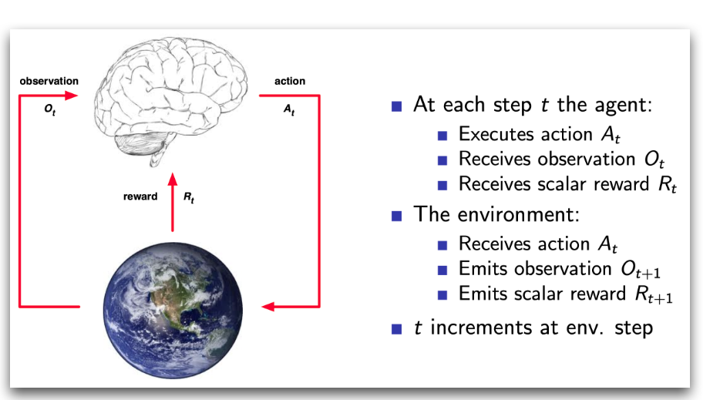
What is RL? – Problem Setting
北师大系统科学学院：面向复杂系统的人工智能，2024

Slide 10
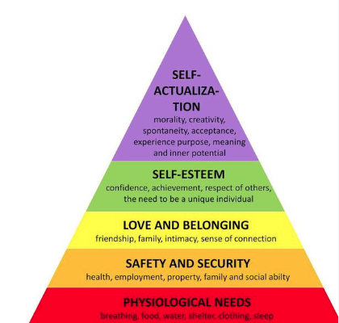
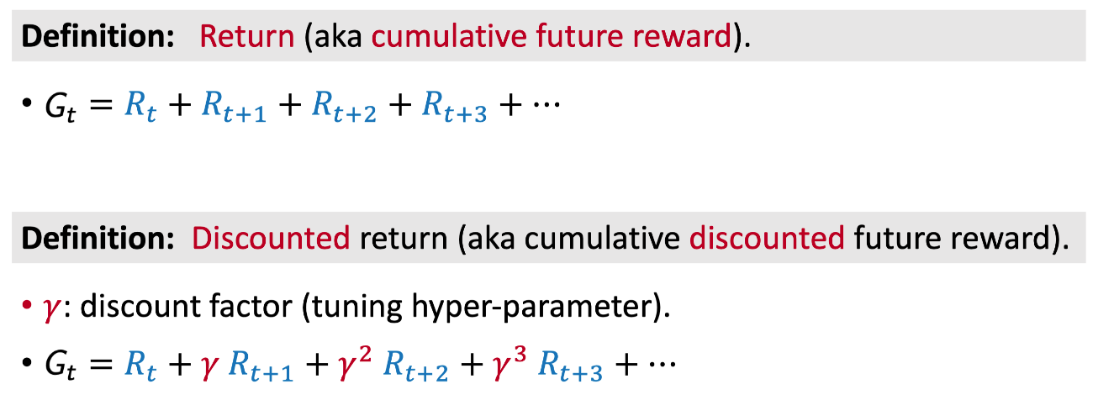
What is RL? – Problem Setting
A reward R_{t} is a scalar feedback signal
The agent’s job is to maximize cumulative reward
Reward Hypothesis
All goals can be described by the maximization of expected cumulative reward
北师大系统科学学院：面向复杂系统的人工智能，2024

Slide 11
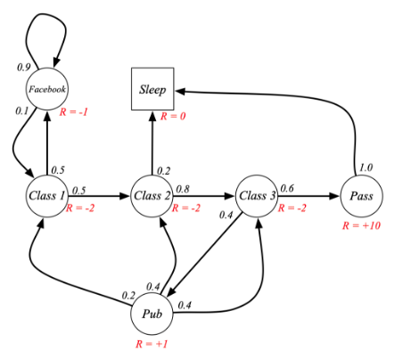
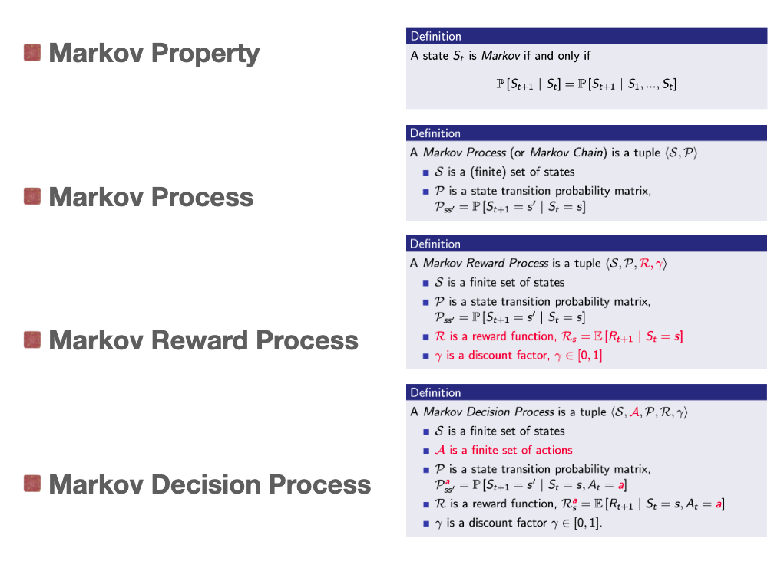
Simplify – Markov Decision Process

Slide 12
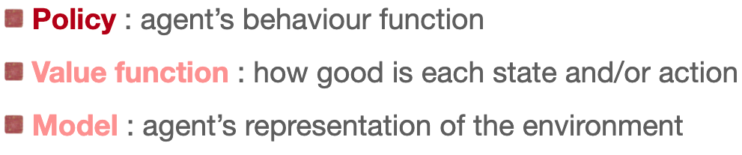
Major Components of an RL Agent
An RL agent may contain one or more these components:
observation
Policy
action
北师大系统科学学院：面向复杂系统的人工智能，2024

Slide 13
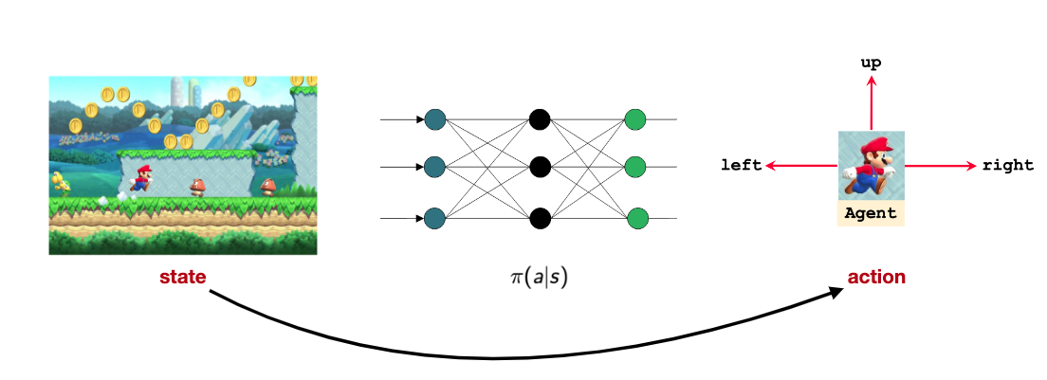
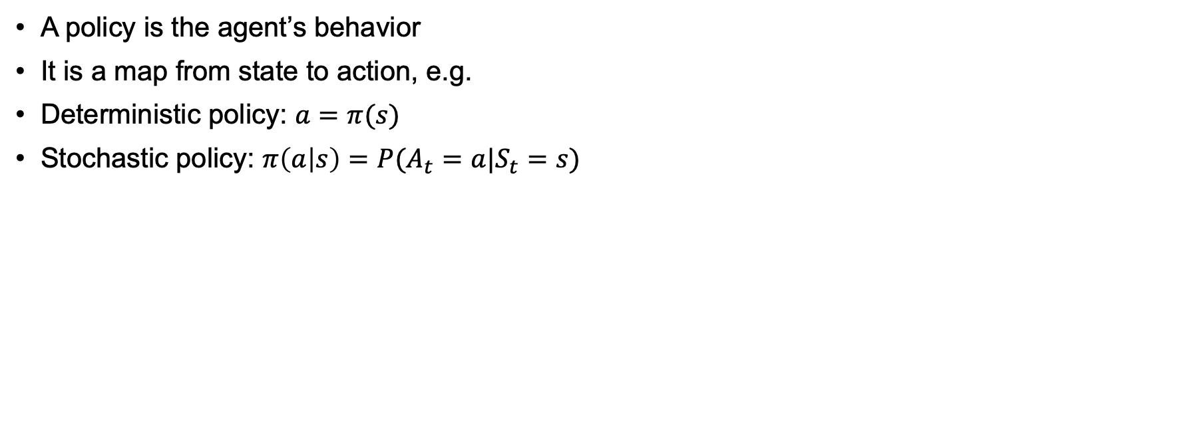
Policy
A policy is the agent’s behavior
It is a map from state to action, e.g.
Deterministic policy: $a=π(s)$
Stochastic policy: $π\left(a | s\right)=P(A_{t}=a|S_{t}=s)$
北师大系统科学学院：面向复杂系统的人工智能，2024

Slide 14

Gumbel softmax
Action 1
A Differential Stochastic Machine
with parameter Θ
Action 2
Probability
Evaluation r
Action 3
Action 4
Action 5
Li, Y., Liu, J., Lin, G. et al. Gumbel-softmax-based optimization: a simple general framework for optimization problems on graphs. Comput Soc Netw 8, 5 (2021).

Slide 15
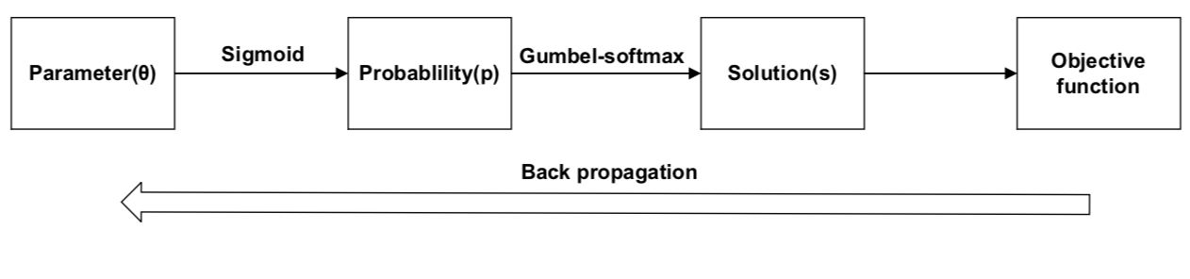
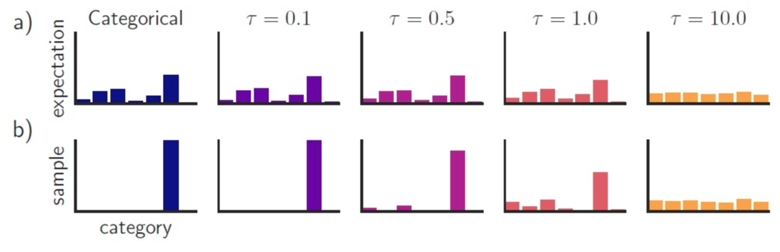
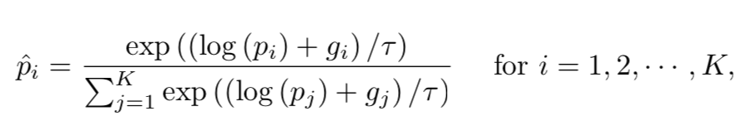
Gumbel softmax based methods
https://arxiv.org/abs/1611.01144

Slide 16
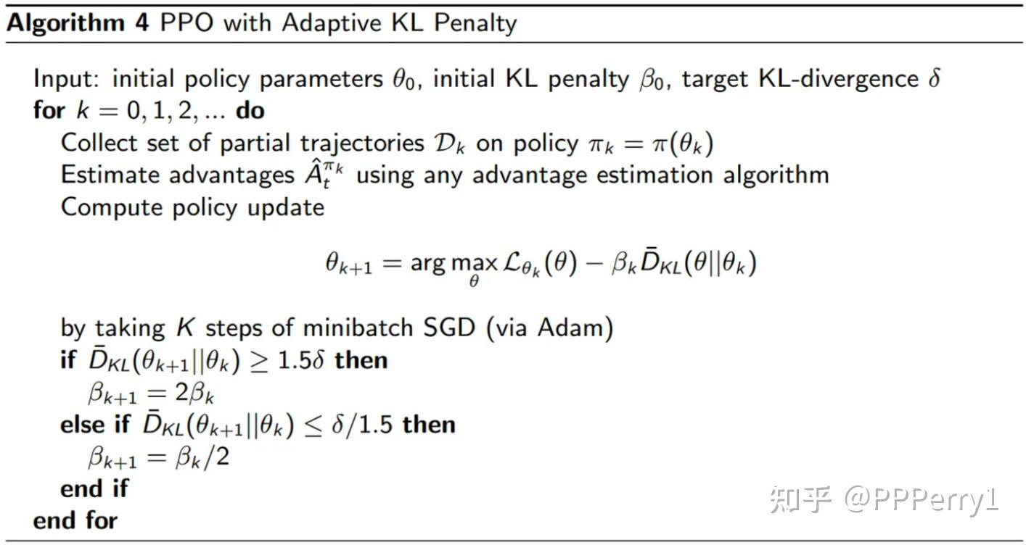
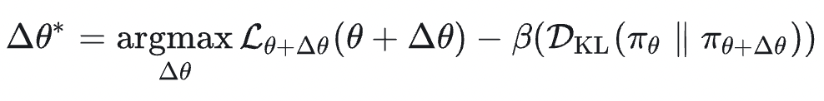
PPO algorithm - adaptive
Proximal Policy Optimization
https://arxiv.org/pdf/1707.06347
https://fse.studenttheses.ub.rug.nl/25709/1/mAI_2021_BickD.pdf

Slide 17
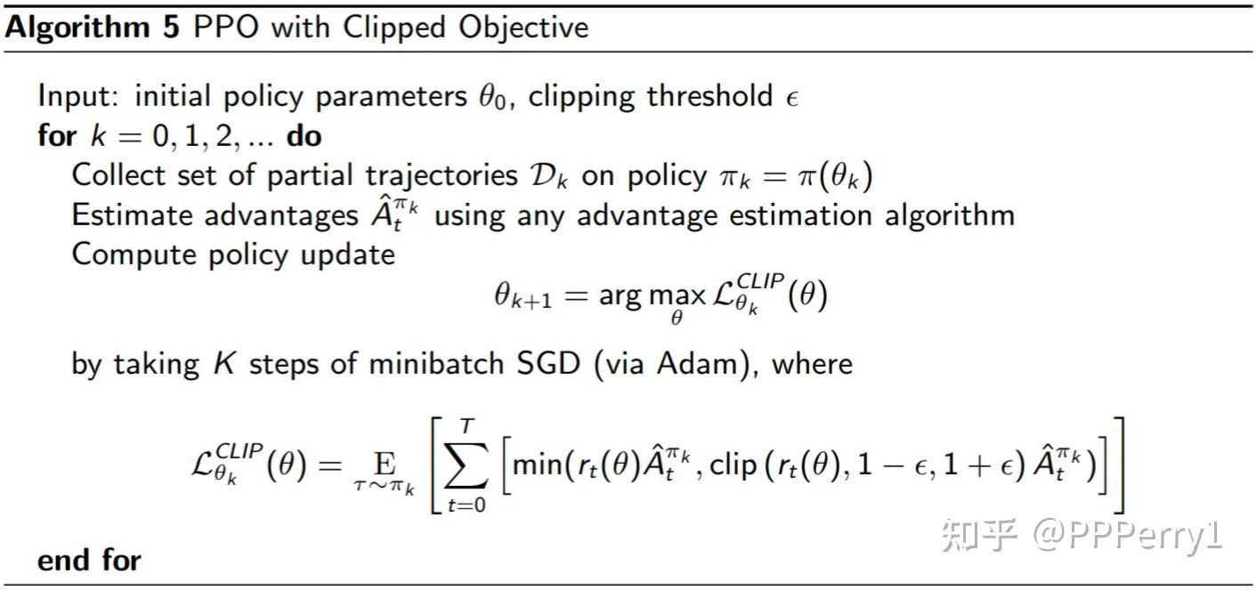
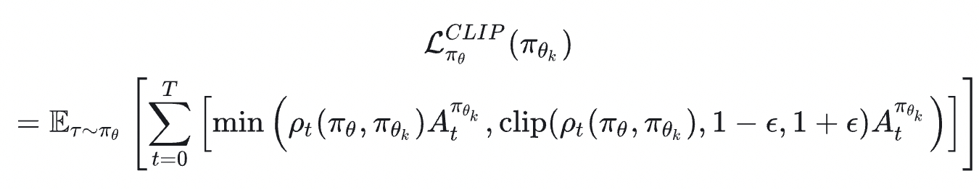
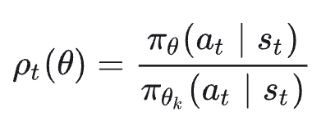
PPO algorithm -clip
https://arxiv.org/pdf/1707.06347
https://fse.studenttheses.ub.rug.nl/25709/1/mAI_2021_BickD.pdf

Slide 18
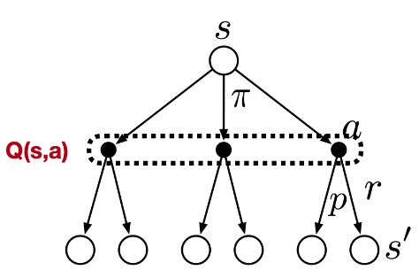
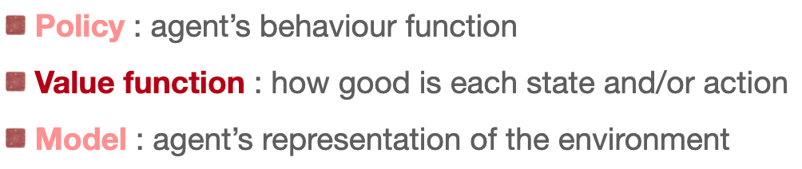
Major Components of an RL Agent
An RL agent may contain one or more these components:
Value
observation
Policy
action
北师大系统科学学院：面向复杂系统的人工智能，2024

Slide 19
Value functions
State-value function: the state-value function $v_{π}(s)$ of an MDP is the expected return starting from state s, and the following policy $π$:
$v_{π}\left(s\right)=𝔼_{π}[G_{t}|S_{t}=s]$
Action-value function: the action-value function $q_{π}(s,a)$ is the expected return starting from state s, taking action a, and then following policy $π$:
$q_{π}\left(s,a\right)=𝔼_{π}[G_{t}|S_{t}=s,A_{t}=a]$
北师大系统科学学院：面向复杂系统的人工智能，2024

Slide 20
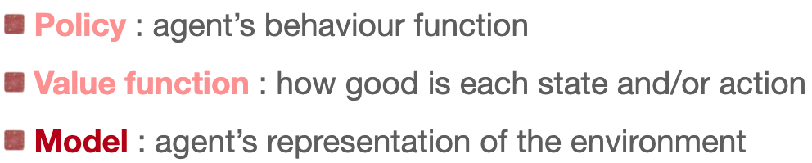
Major Components of an RL Agent
An RL agent may contain one or more these components:
Model
Prediction, planning
Value
observation
Policy
action
北师大系统科学学院：面向复杂系统的人工智能，2024

Slide 21
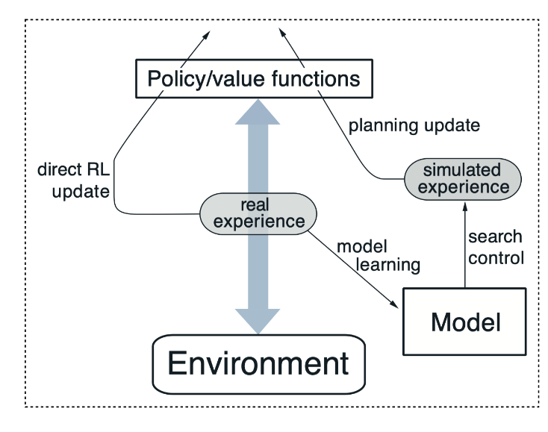
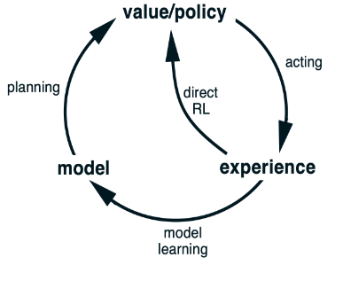
Model
Learn model from experience
Learn behavior in imagination
Act in the environment
Sutton, R.S. (1990). Integrated architectures for learning, planning, and reacting based on approximating dynamic programming. In Machine Learning Proceedings, 216-224, Elsevier, 1990

Slide 22
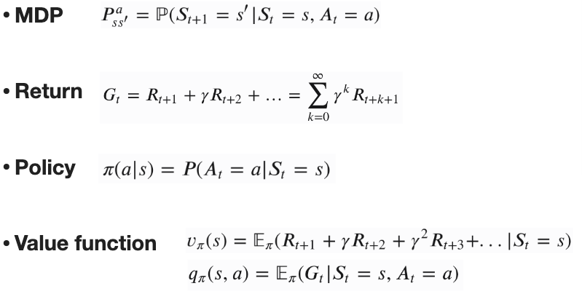
Summary: basic notions
Model
北师大系统科学学院：面向复杂系统的人工智能，2024

Slide 23
Classification
按照Agent对环境的理解程度
Model-free: Q-learning, DQN,…
Model-based: AlphaGo
按照学习对象的划分
Policy based: REINFORCE
Value based: DQN
Policy-value: AlphaGo
Actor-critic: A2C→PPO
北师大系统科学学院：面向复杂系统的人工智能，2024

Slide 24
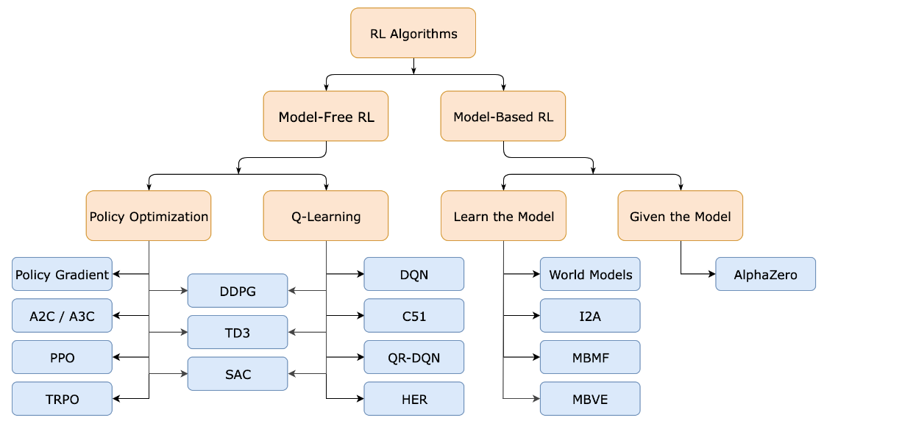
Classification
https://spinningup.openai.com/en/latest/spinningup/rl_intro2.html

Slide 25
Outline
Basic Notions
AlphaGo
Deep Q-Learning
Reinforcement Learning and Causality
World Models
北师大系统科学学院：面向复杂系统的人工智能，2024

Slide 26
Alpha Go
Environment S: configuration
Action of Agent: next move
Transition of Environments: Depend on the opponent player
Feedback: win or lose
Silver, D., Huang, A., Maddison, C. et al. Mastering the game of Go with deep neural networks and tree search. Nature 529, 484–489 (2016).

Slide 27
Architecture of Alpha Go
Searching Phase
Learning Phase
Silver, D., Huang, A., Maddison, C. et al. Mastering the game of Go with deep neural networks and tree search. Nature 529, 484–489 (2016).

Slide 28
Architecture of Alpha Go
SL Policy
RL Policy
Value
Learning Phase
Silver, D., Huang, A., Maddison, C. et al. Mastering the game of Go with deep neural networks and tree search. Nature 529, 484–489 (2016).

Slide 29
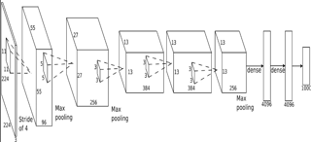
Supervised policy network
Probability of Next Move
13 layers CNN
KBS platform of players
Silver, D., Huang, A., Maddison, C. et al. Mastering the game of Go with deep neural networks and tree search. Nature 529, 484–489 (2016).

Slide 30
Reinforcement Learning Policy Network
Self-play until the end: z=+-1:
Current
Random selected policy network
Policy gradient
Weights
Silver, D., Huang, A., Maddison, C. et al. Mastering the game of Go with deep neural networks and tree search. Nature 529, 484–489 (2016).

Slide 31
Reinforcement Learning Policy Network
Self-play via policy network, until end: z=+-1,
Get average value of z from 30 million games
Weight update
Silver, D., Huang, A., Maddison, C. et al. Mastering the game of Go with deep neural networks and tree search. Nature 529, 484–489 (2016).

Slide 32
Architecture of Alpha Go
Searching Phase
Learning Phase
Silver, D., Huang, A., Maddison, C. et al. Mastering the game of Go with deep neural networks and tree search. Nature 529, 484–489 (2016).

Slide 33
Monte Carlo Tree Search
Number: Win Times/ Total
Multi-times Simulation from one state
Select a move with maximized value
Fast simulation with at un-expanded node (Rollout Policy Network)
Update all weights from bottom up
Silver, D., Huang, A., Maddison, C. et al. Mastering the game of Go with deep neural networks and tree search. Nature 529, 484–489 (2016).

Slide 34
Selection
做选择:
用监督学习训练的走棋网络
次数

Slide 35
Evaluation
For each leaf node:
Value Network
Rollout Policy Network
Silver, D., Huang, A., Maddison, C. et al. Mastering the game of Go with deep neural networks and tree search. Nature 529, 484–489 (2016).

Slide 36
Backup
某一条连边被重复越多，权重越大，越相信它的估值
Silver, D., Huang, A., Maddison, C. et al. Mastering the game of Go with deep neural networks and tree search. Nature 529, 484–489 (2016).

Slide 37
Summary for Mixture
估值网络v
走棋网络ρ
人类经验σ
Q值
V(S)
1-λ
N加权
走棋、选择
快速走棋模拟
人类经验π
λ
人类走棋经验σ
1/N加权
Silver, D., Huang, A., Maddison, C. et al. Mastering the game of Go with deep neural networks and tree search. Nature 529, 484–489 (2016).

Slide 38
Results
Silver, D., Huang, A., Maddison, C. et al. Mastering the game of Go with deep neural networks and tree search. Nature 529, 484–489 (2016).

Slide 39
Outline
Basic Notions
AlphaGo
Deep Q-Learning
Reinforcement Learning and Causality
World Models
北师大系统科学学院：面向复杂系统的人工智能，2024

Slide 40
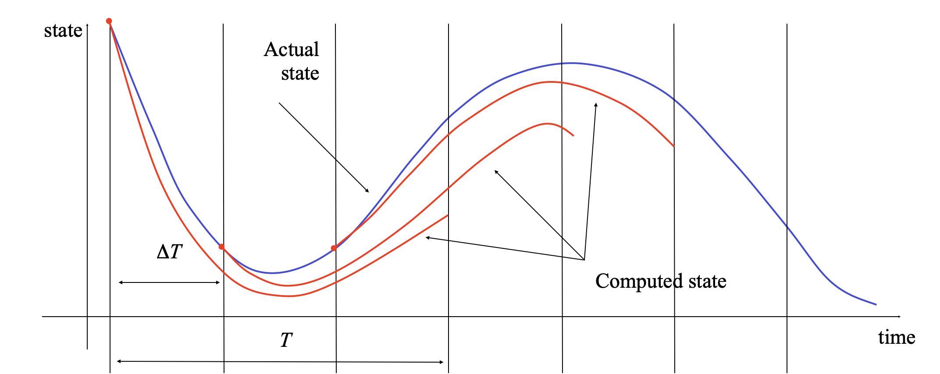
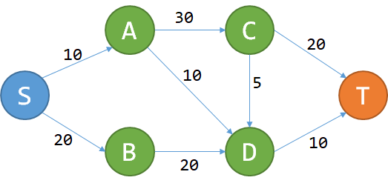
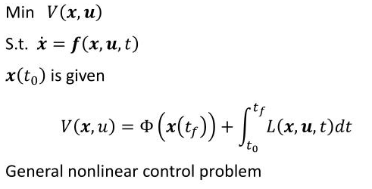
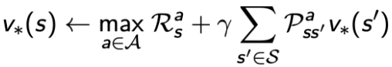
Optimal Control and Dynamic Programming
Optimal Control
Dynamic Programming
https://www.zhihu.com/question/23995189

Slide 41
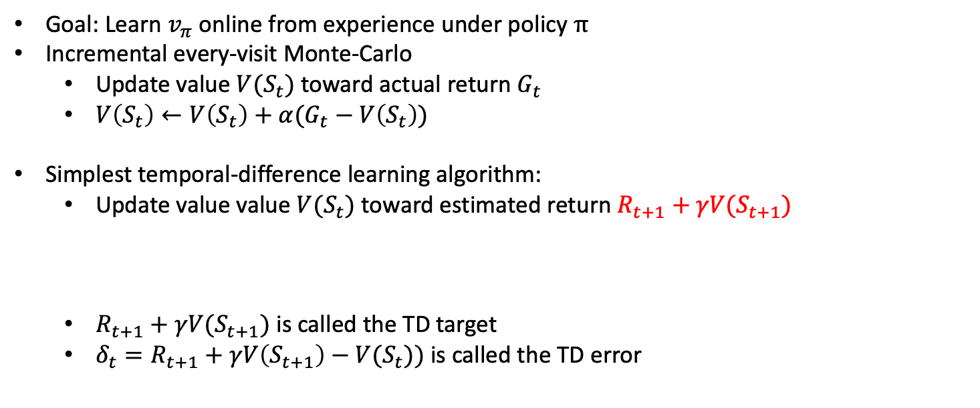
Temporal-difference Learning
Goal: Learn $v_{π}$ online from experience under policy $π$
Incremental every-visit Monte-Carlo
Update value $V(S_{t})$ toward actual return $G_{t}$
$V\left(S_{t}\right)←V\left(S_{t}\right)+α(G_{t}−V\left(S_{t}\right))$
Simplest temporal-difference learning algorithm:
Update value value $V(S_{t})$ toward estimated return $R_{t+1}+γV(S_{t+1})$
$R_{t+1}+γV(S_{t+1})$ is called the TD target
$δ_{t}=R_{t+1}+γV\left(S_{t+1}\right)−V(S_{t}))$ is called the TD error
$$V\left(S_{t}\right)←V\left(S_{t}\right)+α(R_{t+1}+γV\left(S_{t+1}\right)−V(S_{t}))$$
Arthur Samuel
北师大系统科学学院：面向复杂系统的人工智能，2024

Slide 42
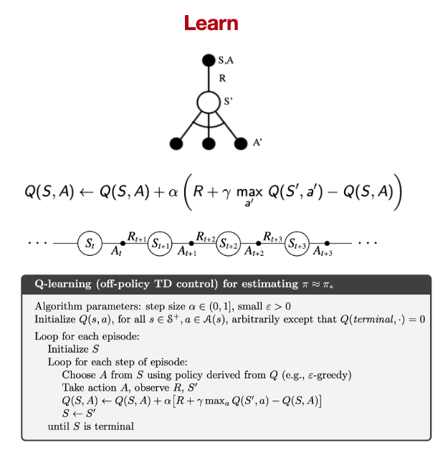
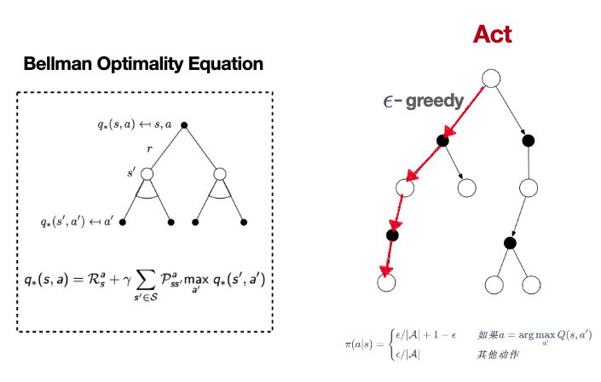
Q-Learning Algorithm
北师大系统科学学院：面向复杂系统的人工智能，2024

Slide 43
Deep Q Network
Human-level control through deep reinforcement learning https://www.nature.com/articles/nature14236

Slide 44
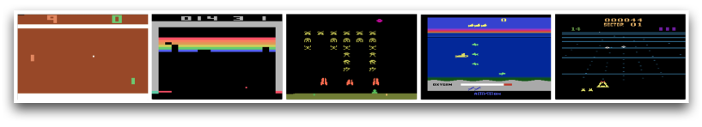
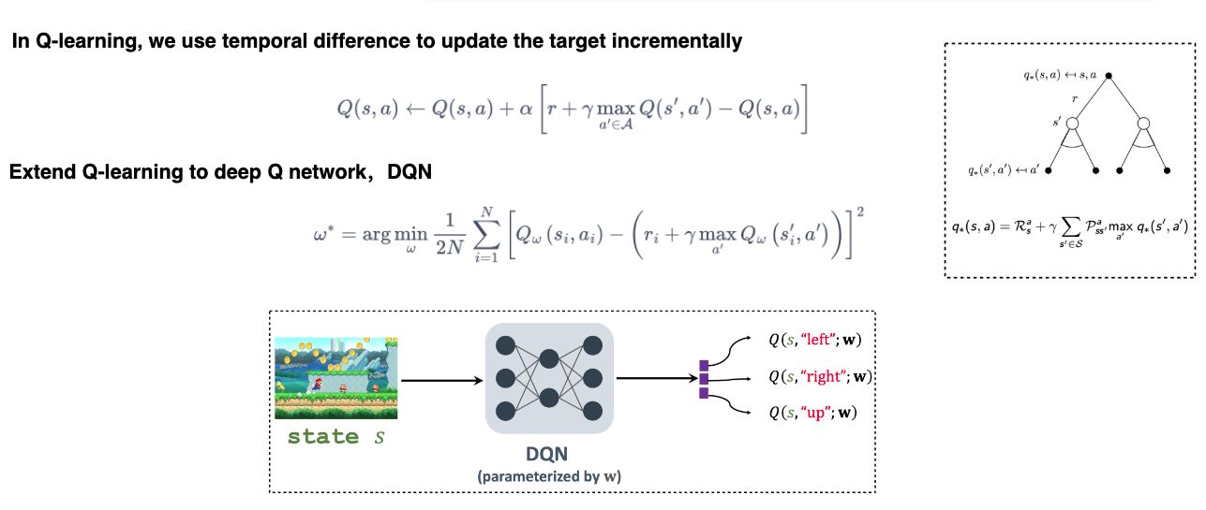
Deep Q Network
Human-level control through deep reinforcement learning https://www.nature.com/articles/nature14236

Slide 45
Deep Q Network
s'
s
a
r
Human-level control through deep reinforcement learning https://www.nature.com/articles/nature14236

Slide 46
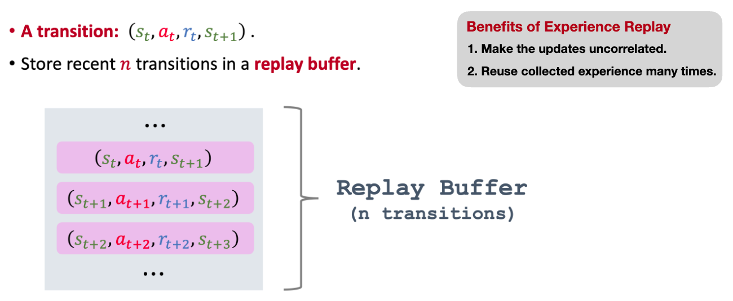
Experience Replay
Human-level control through deep reinforcement learning https://www.nature.com/articles/nature14236

Slide 47
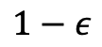
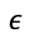
One Step Action
𝜖贪婪
随机行动a(t)
$$ε$$
调用游戏引擎，进行一步游戏，返回s‘,r
将(s,a,r,s’,T)放入训练集D中
从D中随机抽取一个Batch，训练网络
开始
随机产生一个ϵ
根据场景，调用网络，生成行动a(t)
$$1−ε$$
Human-level control through deep reinforcement learning https://www.nature.com/articles/nature14236

Slide 48
One Step Learning
Target=r
从D中随机抽取出一个mini-batch: (S,A,R,S’,T)
循环(S,A,R,S’,T)中的每一个s,a,r,s’,t
T
计算误差L=(Q(s,a)-Target)²
L.backward()
Optimizer.step()
开始
将s’送入神经网络得出maxQ(s’,a’)
Target=r +ϒ maxQ(s’,a’)
Not T
Human-level control through deep reinforcement learning https://www.nature.com/articles/nature14236

Slide 49
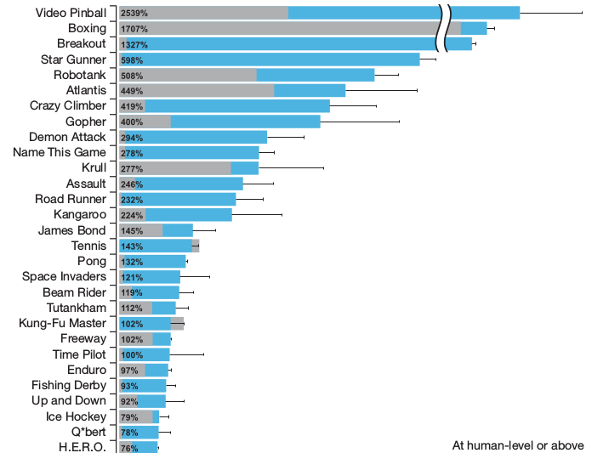
Results
Human-level control through deep reinforcement learning https://www.nature.com/articles/nature14236

Slide 50
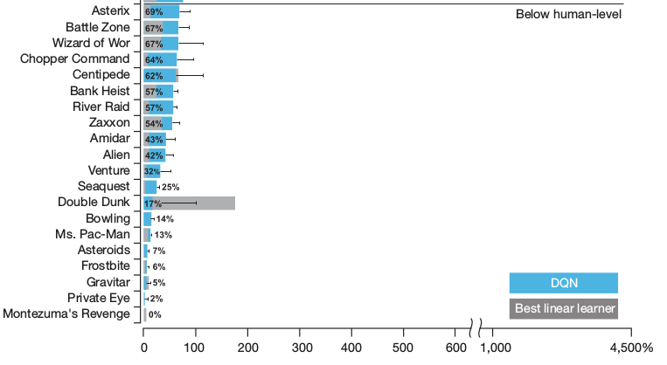
Results
Human-level control through deep reinforcement learning https://www.nature.com/articles/nature14236

Slide 51
Emergent Abilities
Human-level control through deep reinforcement learning https://www.nature.com/articles/nature14236

Slide 52
Visualization
蓝色：人类
橙色：机器
Human-level control through deep reinforcement learning https://www.nature.com/articles/nature14236

Slide 53
DQN - AGI
Artificial general intelligence (AGI) is the intelligence of a machine that could successfully perform any intellectual task that a human being can.
DQN可以看作游戏世界中的AGI
Human-level control through deep reinforcement learning https://www.nature.com/articles/nature14236

Slide 54
Outline
Basic Notions
AlphaGo
Deep Q-Learning
Causal Reinforcement Learning
World Models
北师大系统科学学院：面向复杂系统的人工智能，2024

Slide 55
Causality and Intervention
A
B
C
E
D
北师大系统科学学院：面向复杂系统的人工智能，2024

Slide 56
Causality and Intervention
A
B
C
Interaction, Intervention
E
D
北师大系统科学学院：面向复杂系统的人工智能，2024

Slide 57
Causality and Intervention
A
B
C
E
How to do action
D
北师大系统科学学院：面向复杂系统的人工智能，2024

Slide 58
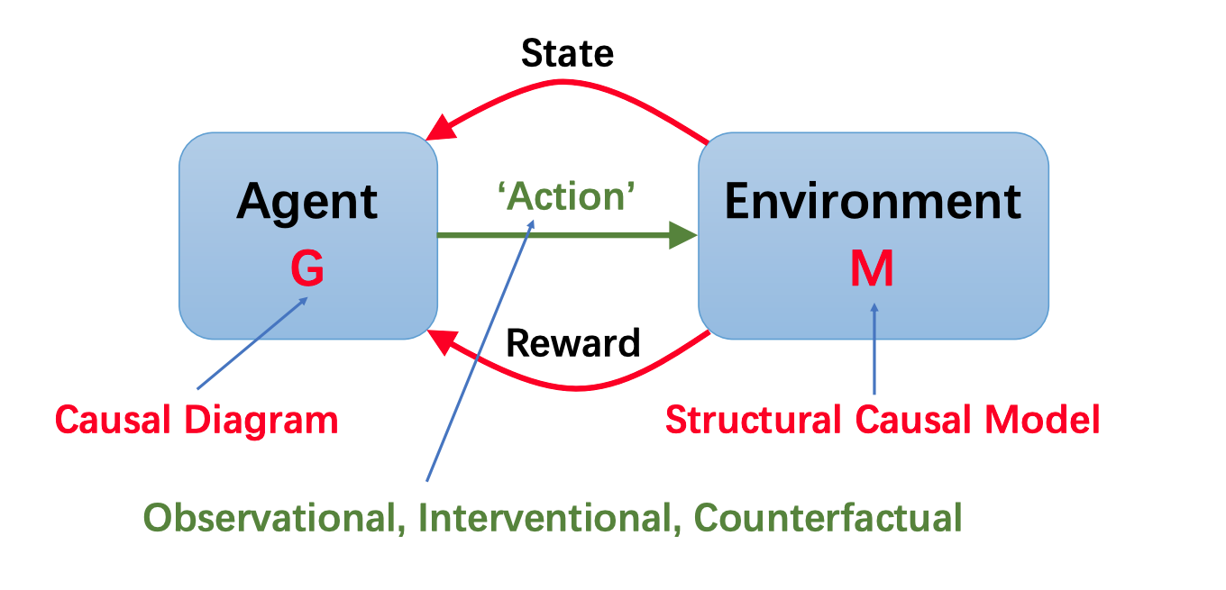
Causal Reinforcement Learning
Chaochao Lu, Nov 2023 in Swarma Club

Slide 59
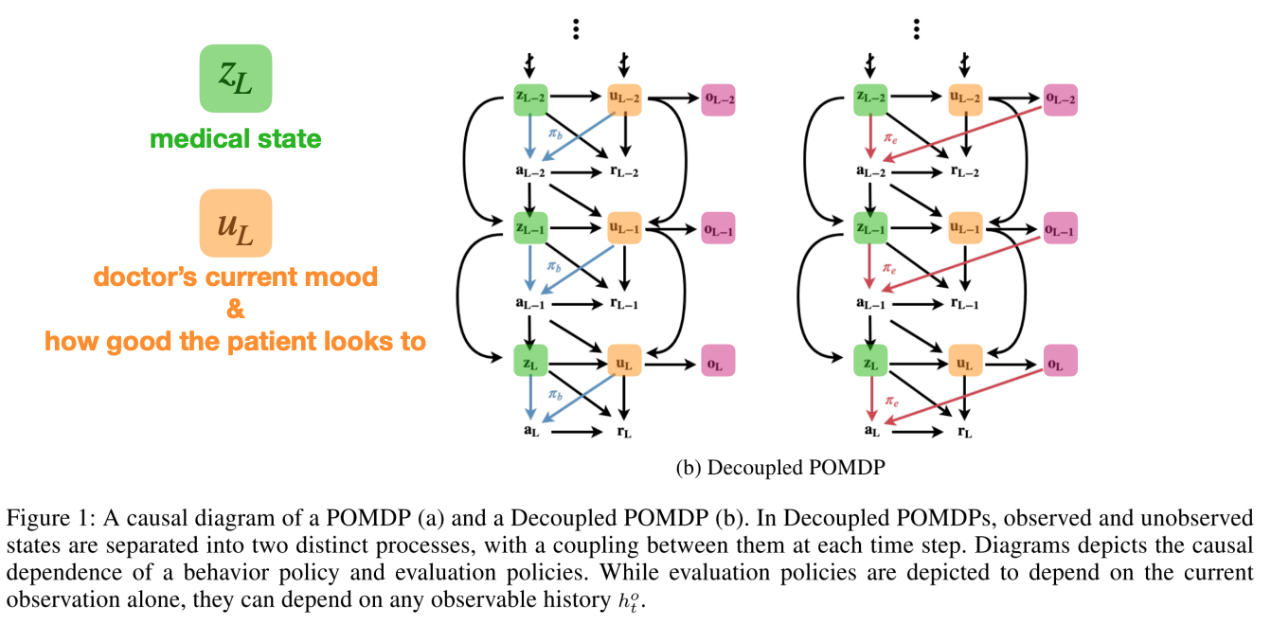
Observational: off-policy evaluation
Tennenholtz et al. Off-Policy Evaluation in Partially Observable Environments. 2019

Slide 60
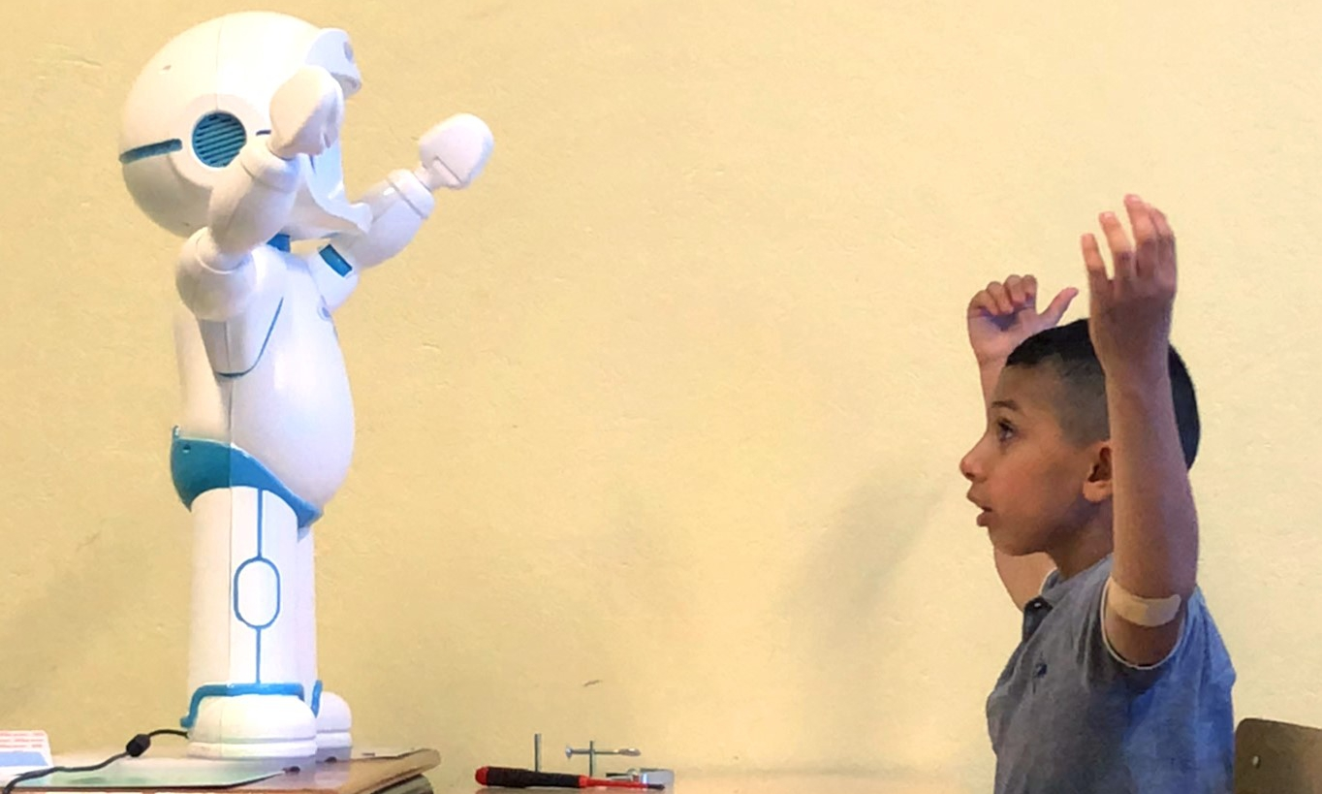
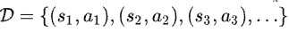
Observational: Imitation Learning
de Hann et al. Causal Confusion in Imitation Learning, 2018

Slide 61
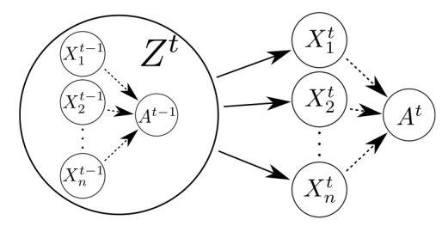

Interventional: self-driving
de Hann et al. Causal Confusion in Imitation Learning, 2018

Slide 62


Interventional: self-driving
de Hann et al. Causal Confusion in Imitation Learning, 2018

Slide 63

Counterfactual: policy search
Buesing et al. Woulda, Coulda, Shoulda: Counterfactually-Guided Policy Search, 2019
Notes:
将强化学习策略看作是一个SCM，左图，右图为时间的展开。这个研究工作的问题是，如何对一个策略进行评估，以及如何更新一个策略。传统的方法是根据已有的策略，进行适当地微扰，通过重采样加权，得到一个新的策略，从而通过采样得到多个样本计算平均的累计回报，得到策略的估值。论文提出了一种新的方法，即通过反事实来进行重新的估计。这样做的好处就是可以de-bias这个model（？，可能是正事实和反事实都考虑了吧）。具体在迷宫这个实验中，系统假设环境的机制等信息都已知了，未知的就只有出事条件U_1，因此，论文通过一个backward RNN推断出Z变量，通过Z喂入DRAW模型，绘制初始条件的分布（即U_1），从而在初始条件下执行策略，形成多个样本，估算策略。同时也可以更新策略（根据原文中的1式）。

Slide 64



Counterfactual: policy search
Buesing et al. Woulda, Coulda, Shoulda: Counterfactually-Guided Policy Search, 2019
Notes:
Motivation When should one prefer CF-PE over the more straightforward MB-PE? Assuming a perfect model, Corollary 2 states that both yield the same answer in expectation for perfect models. For imperfect models however, these algorithms can differ substantially. MB-PE relies on purely synthetic data, sampled from the noise distribution p(U). In practice, this is usually approximated by a parametric density model, which can lead to under-fitting in case of complex distributions. This is a well-known effect in generative models with latent variables: In spite of recent research progress, e.g. models of natural images are still unable to accurately model the variability of the true data (Gregor et al., 2016). In contrast, CF-PE samples from the posterior N −1 PN i=1 p µ(U|hˆi T ), which has access to strictly more information than the prior p(U) by taking into account additional data hˆi T . This semi-nonparametric distribution can help to de-bias the model by effectively winnowing 5 out parts of the domain of U which do not correspond to any real data. We substantiate this intuition with experiments below; a concrete illustration for the difference between the prior and posterior / counterfactual distribution is given in fig. 4 in the appendix and discussed in appendix D. Therefore, we conclude that we expect CF-PE to outperform MB-PE, if the transition and reward kernels fst are accurate models of the environment dynamics, but if the marginal distribution over the noise sources PU is difficult to model.

Slide 65

Counterfactual: policy search
Buesing et al. Woulda, Coulda, Shoulda: Counterfactually-Guided Policy Search, 2019
Notes:
可以反推各种U，一旦有了U之后，可以生成新的数据，这些数据都是在事实附近的微扰
Figure 3: Top: PO-SOKOBAN. Shown on the left is a procedurally generated initial state. The agent is shown in green, boxes in yellow, targets in blue and walls in red. The agent does not observe this state but a sequence of observations, which are masked by iid noise with 0.9 probability, except a 3x3 window around the agent. Bottom: Inference model. For counterfactual inference in PO-SOKOBAN, we need the (approximate) inference distribution p(Us1|hˆ T ) over the initial state Us1 = S1, conditioned on the history of observations hˆ T . We model this distribution using a DRAW generative model with latent variables Z, which are conditioned on the output of a backward RNN summarizing the observation history.

Slide 66

Causal Discovery
Zhu S, Ng I, Chen Z. Causal discovery with reinforcement learning, ICLR 2020

Slide 67


Causal Discovery
1. the predefined score function； 2. two penalty terms to enforce acyclicity
Zhu S, Ng I, Chen Z. Causal discovery with reinforcement learning, ICLR 2020

Slide 68

Problems Overview
Kaddour et al. 2022: https://arxiv.org/abs/2206.15475

Slide 69
Outline
Basic Notions
AlphaGo
Deep Q-Learning
Causal Reinforcement Learning
World Models
北师大系统科学学院：面向复杂系统的人工智能，2024

Slide 70
Hierarchy of Causality
Judea Pearl: The Book of Why

Slide 71


World Models
https://arxiv.org/pdf/1803.10122.pdf

Slide 72


World Models
https://arxiv.org/pdf/1803.10122.pdf

Slide 73


World Model – VAE encoder
https://arxiv.org/pdf/1803.10122.pdf

Slide 74

World Model – VAE encoder
https://arxiv.org/pdf/1803.10122.pdf

Slide 75



World Model – MDP RNN
https://blog.csdn.net/KuXiaoQuShiHuai/article/details/109692063
https://arxiv.org/pdf/1803.10122.pdf

Slide 76


World Model – MDP RNN
https://arxiv.org/pdf/1803.10122.pdf

Slide 77

Controller
We used Covariance-Matrix Adaptation Evolution Strategy (CMA-ES) (Hansen, 2016) to evolve the weights for our C Model. Following the approach described in Evolving Stable Strategies (Ha, 2017b), we used a population size of 64, and had each agent perform the task 16 times with different initial random seeds. The fitness value for the agent is the average cumulative reward of the 16 random rollouts. The diagram below charts the best performer, worst performer, and mean fitness of the population of 64 agents at each generation
https://arxiv.org/pdf/1803.10122.pdf

Slide 78


Car racing experiments
https://arxiv.org/pdf/1803.10122.pdf

Slide 79


Dreaming
https://arxiv.org/pdf/1803.10122.pdf

Slide 80


Dreaming
dead
https://arxiv.org/pdf/1803.10122.pdf

Slide 81

About temperature
https://arxiv.org/pdf/1803.10122.pdf

Slide 82


Iterative Training Procedure
https://arxiv.org/pdf/1803.10122.pdf

Slide 83



Dreamers
https://arxiv.org/abs/1912.01603

Slide 84

Components of Dreamer
https://arxiv.org/abs/1912.01603

Slide 85

Algorithm
Action model
Value network
https://arxiv.org/abs/1912.01603

Slide 86

Results
https://arxiv.org/abs/1912.01603

Slide 87

Results
https://arxiv.org/abs/1912.01603

Slide 88


Dreamers V2
https://arxiv.org/abs/2301.04104

Slide 89

Dreamers V2
https://arxiv.org/abs/2301.04104

Slide 90

Dreamers V2
https://arxiv.org/abs/2301.04104

Slide 91

Dreamer V3
Hafner, D., Pasukonis, J., Ba, J. et al. Mastering diverse control tasks through world models. Nature (2025). https://doi.org/10.1038/s41586-025-08744-2

Slide 92

Dreamer V3
Hafner, D., Pasukonis, J., Ba, J. et al. Mastering diverse control tasks through world models. Nature (2025). https://doi.org/10.1038/s41586-025-08744-2

Slide 93

Diverse visual domains used in the experiments
Hafner, D., Pasukonis, J., Ba, J. et al. Mastering diverse control tasks through world models. Nature (2025). https://doi.org/10.1038/s41586-025-08744-2

Slide 94


Models
Hafner, D., Pasukonis, J., Ba, J. et al. Mastering diverse control tasks through world models. Nature (2025). https://doi.org/10.1038/s41586-025-08744-2

Slide 95


Models
$c_{t}∈\{0,1\}$ flag if continue problem
Hafner, D., Pasukonis, J., Ba, J. et al. Mastering diverse control tasks through world models. Nature (2025). https://doi.org/10.1038/s41586-025-08744-2

Slide 96

Results
Hafner, D., Pasukonis, J., Ba, J. et al. Mastering diverse control tasks through world models. Nature (2025). https://doi.org/10.1038/s41586-025-08744-2

Slide 97

Results
Hafner, D., Pasukonis, J., Ba, J. et al. Mastering diverse control tasks through world models. Nature (2025). https://doi.org/10.1038/s41586-025-08744-2

Slide 98

Results
Hafner, D., Pasukonis, J., Ba, J. et al. Mastering diverse control tasks through world models. Nature (2025). https://doi.org/10.1038/s41586-025-08744-2

Slide 99

Dreamer V3
Problems：
World without self
Dreaming is not autonomous
https://arxiv.org/abs/2301.04104

Slide 100


From System 1 to System 2
卡尼曼：思考，快与慢，中信出版社

Slide 101


Self awareness
Dynamic Attention
https://arxiv.org/pdf/2204.07184.pdf

Slide 102


Consciousness Machine？
https://arxiv.org/pdf/cs/0309048.pdf

